Slide 1
Naïve Bayes Classification

Slide 2
Introduction
Naive Bayes is among one of the most simple and powerful algorithms for classification based on Bayes’ Theorem with an assumption of independence among predictors.
Naive Bayes model is easy to build and particularly useful for very large data sets. There are two parts to this algorithm:
Naive
Bayes
The Naive Bayes classifier assumes that the presence of a feature in a class is unrelated to any other feature. The Algorithm is ‘naive’ because it makes assumptions that may or may not turn out to be correct.

Slide 3
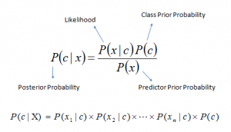
Bayes Theorem
In Statistics and probability theory, Bayes’ theorem describes the probability of an event, based on prior knowledge of conditions that might be related to the event. It serves as a way to figure out conditional probability.
Bayes theorem provides a way of calculating posterior probability P(c|x) from P(c), P(x) and P(x|c). Look at the equation below:
P(c|x) is the posterior probability of class (c, target) given predictor (x, attributes).
P(c) is the prior probability of class.
P(x|c) is the likelihood which is the probability of predictor given class.
P(x) is the prior probability of predictor.

Slide 4
Contd..
Naive Bayes model is easy to build and particularly useful for very large data sets.
Along with simplicity, Naive Bayes is known to outperform even highly sophisticated classification methods.

Slide 5

Contd..
If we put a naive assumption to the Bayes’ theorem, which is, independence among the features. So now, we split evidence into the independent parts.
Now, if any two events A and B are independent, then,
P(A,B) = P(A)P(B)
Hence, we reach to the result:
which can be expressed as:
Now, as the denominator remains constant for a given input, we can remove that term:

Slide 6
Naïve Bayes Algorithm
Now, we need to create a classifier model. For this, we find the probability of given set of inputs for all possible values of the class variable y and pick up the output with maximum probability. This can be expressed mathematically as:
So, finally, we are left with the task of calculating P(y) and P(xi | y).
Please note that P(y) is also called class probability and P(xi | y) is called conditional probability.
The different naive Bayes classifiers differ mainly by the assumptions they make regarding the distribution of P(xi | y).

Slide 7
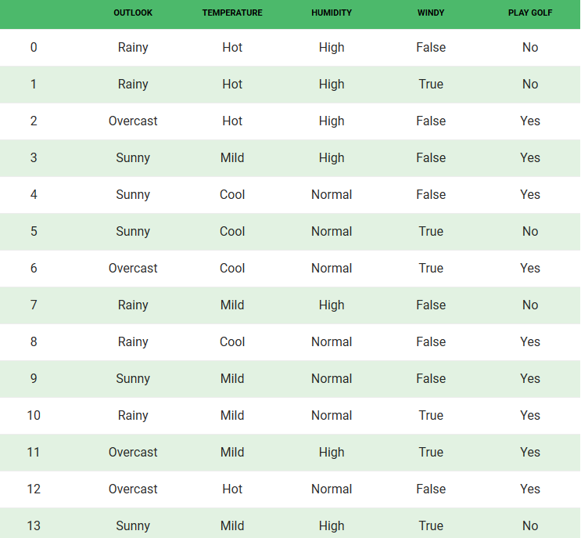
Prediction using Bayes Theorem - Example
The dataset is divided into two parts, namely, feature matrix and the response vector.
Feature matrix contains all the vectors(rows) of dataset in which each vector consists of the value of dependent features. In above dataset, features are ‘Outlook’, ‘Temperature’, ‘Humidity’ and ‘Windy’.
Response vector contains the value of class variable(prediction or output) for each row of feature matrix. In above dataset, the class variable name is ‘Play golf’.

Slide 8
Assumptions
The fundamental Naive Bayes assumption is that each feature makes an:
independent
Equal contribution to the outcome.
With relation to our dataset, this concept can be understood as:
We assume that no pair of features are dependent. For example, the temperature being ‘Hot’ has nothing to do with the humidity or the outlook being ‘Rainy. Hence, the features are assumed to be independent.
Secondly, each feature is given the same weight(or importance). For example, knowing only temperature and humidity alone can’t predict the outcome accurately. None of the attributes is irrelevant and assumed to be contributing equally to the outcome.
Note: The assumptions made by Naive Bayes are not generally correct in real-world situations. In-fact, the independence assumption is never correct but often works well in practice.

Slide 9
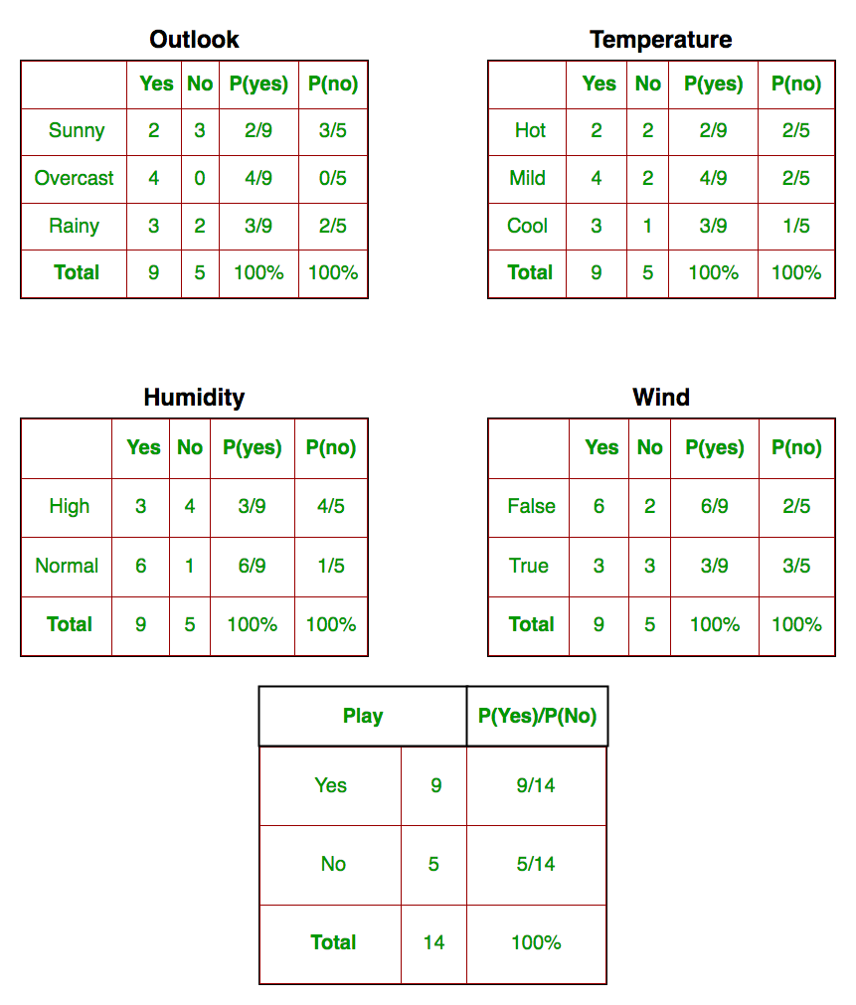
Example contd..
We need to find P(x_{i} | y_{j}) for each x_{i} in X and y_{j} in y. All these calculations have been demonstrated in the tables below:
We have calculated P(x_{i} | y_{j}) for each x_{i} in X and y_{j} in y manually in the tables 1-4. For example, probability of playing golf given that the temperature is cool, i.e
P(temp = cool | play golf = Yes) = 3/9.
Also, we need to find class probabilities (P(y)) which has been calculated in the table 5. For example, P(play golf = Yes) = 9/14.
So now, we are done with our pre-computations and the classifier is ready!

Slide 10
Let us test it on a new set of features (let us call it today):
today = (Sunny, Hot, Normal, False)
So, probability of playing golf is given by:
and probability to not play golf is given by:
Since, P(today) is common in both probabilities, we can ignore P(today) and find proportional probabilities as:
and
Test – Rainy, Mild, High, False

Slide 11
Now, since
These numbers can be converted into a probability by making the sum equal to 1 (normalization):
And
Since
So, prediction that golf would be played is ‘Yes’.

Slide 12
Contd..
The method that we discussed above is applicable for discrete data. In case of continuous data, we need to make some assumptions regarding the distribution of values of each feature.
The different naive Bayes classifiers differ mainly by the assumptions they make regarding the distribution of P(x_{i} | y).

Slide 13
Zero Probability
Suppose there is no tuple for a risky loan in the dataset, in this scenario, the posterior probability will be zero, and the model is unable to make a prediction. This problem is known as Zero Probability because the occurrence of the particular class is zero.
The solution for such an issue is the Laplacian correction or Laplace Transformation.
Laplacian correction is one of the smoothing techniques. Here, you can assume that the dataset is large enough that adding one row of each class will not make a difference in the estimated probability.
This will overcome the issue of probability values to zero.

Slide 14

Laplacian Correction
For Example: Suppose that for the class loan risky, there are 1000 training tuples in the database. In this database, income column has 0 tuples for low income, 990 tuples for medium income, and 10 tuples for high income. The probabilities of these events, without the Laplacian correction, are 0, 0.990 (from 990/1000), and 0.010 (from 10/1000)
Now, apply Laplacian correction on the given dataset. Let's add 1 more tuple for each income-value pair. The probabilities of these events:

Slide 15
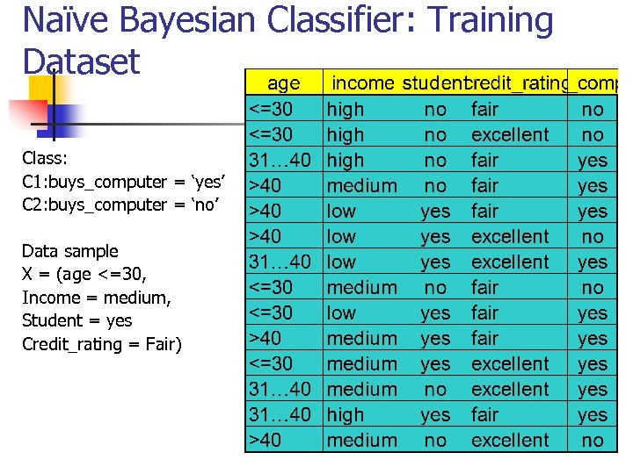
Try Solving this…………….

Slide 16

Contd..
Naive Bayes can be extended to real-valued attributes, most commonly by assuming a Gaussian distribution.
This extension of naive Bayes is called Gaussian Naive Bayes. Other functions can be used to estimate the distribution of the data, but the Gaussian (or Normal distribution) is the easiest to work with because you only need to estimate the mean and the standard deviation from your training data.
Probabilities of new x values are calculated using the Gaussian Probability Density Function (PDF).
When making predictions these parameters can be plugged into the Gaussian PDF with a new input for the variable, and in return the Gaussian PDF will provide an estimate of the probability of that new input value for that class

Slide 17
Advantages
It is not only a simple approach but also a fast and accurate method for prediction.
Naive Bayes has very low computation cost.
It can efficiently work on a large dataset.
It performs well in case of discrete response variable compared to the continuous variable.
It can be used with multiple class prediction problems.
It also performs well in the case of text analytics problems.
When the assumption of independence holds, a Naive Bayes classifier performs better compared to other models like logistic regression.

Slide 18
Disadvantages
The assumption of independent features. In practice, it is almost impossible that model will get a set of predictors which are entirely independent.
If there is no training tuple of a particular class, this causes zero posterior probability. In this case, the model is unable to make predictions. This problem is known as Zero Probability/Frequency Problem.

Slide 19
Some Key Points
Categorical Inputs: Naive Bayes assumes label attributes such as binary, categorical or nominal.
Gaussian Inputs: If the input variables are real-valued, a Gaussian distribution is assumed. In which case the algorithm will perform better if the univariate distributions of your data are Gaussian or near-Gaussian. This may require removing outliers (e.g. values that are more than 3 or 4 standard deviations from the mean).
Classification Problems: Naive Bayes is a classification algorithm suitable for binary and multiclass classification.
Log Probabilities: The calculation of the likelihood of different class values involves multiplying a lot of small numbers together. This can lead to an underflow of numerical precision. As such it is good practice to use a log transform of the probabilities to avoid this underflow.
Kernel Functions: Rather than assuming a Gaussian distribution for numerical input values, more complex distributions can be used such as a variety of kernel density functions.
Update Probabilities: When new data becomes available, you can simply update the probabilities of your model. This can be helpful if the data changes frequently.

Slide 20
Applications
Real time Prediction: Naive Bayes is an eager learning classifier and it is sure fast. Thus, it could be used for making predictions in real time.
Multi class Prediction: This algorithm is also well known for multi class prediction feature. Here we can predict the probability of multiple classes of target variable.
Text classification/ Spam Filtering/ Sentiment Analysis: Naive Bayes classifiers are mostly used in text classification. Due to better result in multi class problems and independence rule it has higher success rate as compared to other algorithms. As a result, it is widely used in Spam filtering (identify spam e-mail) and Sentiment Analysis (in social media analysis, to identify positive and negative customer sentiments)
Recommendation System: Naive Bayes Classifier and Collaborative Filtering together builds a Recommendation System that uses machine learning and data mining techniques to filter unseen information and predict whether a user would like a given resource or not

Slide 21
THANK YOU

